Slide 1


Slide 2
ORM - The tip of an iceberg
Things you may not know about SQL if you’re stuck with ORMs

Slide 3
Processing 10 million sales
10 million sales in a month
10 employees
Generating report with sum of daily sales grouped by day in the month
We’re working with local DB and therefore ignoring latency.

Slide 4
Processing 10 million sales
public interface ISale
{
Guid Id { get; }
int Amount { get; }
DateTime DateTime { get; }
Guid EmployeeId { get; }
}

Slide 5
Processing 10 million sales – generating
var sales = Enumerable.Range(1, 10000000)
.Select(n => new Sale
{
Id = Guid.NewGuid(),
Amount = random.Next(10, 100),
DateTime = new DateTime(2018, now.Month, n % 28 + 1, n % 24, n % 60, 0),
EmployeeId = employeesIds[random.Next(0, employeesIds.Length)]
})
.ToArray();

Slide 6
Processing 10 million sales – processing
var salesGroupedByDay = sales
.Where(s => s.EmployeeId == employeedId)
.GroupBy(s => s.DateTime.Date)
.ToDictionary(
g => g.Key,
g => g.Select(s=>s.Amount).Sum());

Slide 7
Processing 10 million sales – in memory
Generating sales: ~2,8s (irrelevant)
Processing elements: ~0,25s
Total: ~3,05s

Slide 8
Processing 10 million sales – table
CREATE TABLE [dbo].[RawSales]
(
[Id] uniqueidentifier NOT NULL
[Amount] int NOT NULL,
[DateTime] datetime NOT NULL,
[EmployeeId] uniqueidentifier NOT NULL
)

Slide 9
Processing 10 million sales – fetching entire table
var sales = dbContext.Sales
.ToList();

Slide 10
Processing 10 million sales – fetched entire table
Fetching records: ~88,5s
Processing elements: ~0,5s
Total: ~89s

Slide 11
Processing 10 million sales – AsNoTracking()
var sales = dbContext.Sales
.AsNoTracking()
.ToList();

Slide 12
Processing 10 million sales – AsNoTracking()
Fetching records: ~20,7s
Processing elements: ~0,25s
Total: ~20,95s

Slide 13
Processing 10 million sales – filtering on DB side
var sales = dbContext.Sales
.AsNoTracking()
.Where(s=>s.EmployeeId == employeeId)
.ToList();

Slide 14
Processing 10 million sales – Where on DB side
Fetching records: ~1,5s
Processing elements: ~0,1s
Total: ~1,6s

Slide 15
Processing 10 million sales – just columns we need
var sales = dbContext.Sales
.AsNoTracking()
.Where(s=>s.EmployeeId == employeeId)
.Select(s => new
{
s.DateTime,
s.Amount
})
.ToList();

Slide 16
Processing 10 million sales – just columns we need
Fetching records: ~650ms
Processing elements: ~90ms
Total: ~740ms

Slide 17
Processing 10 million sales – aggregating in DB
var sales = dbContext.Sales
.AsNoTracking()
//Filtering and projection
.GroupBy(s => s.DateTime.Date)
.ToDictionary(g => g.Key,
g => g.Select(s => s.Amount).Sum())

Slide 18
NotSupportedException!
var sales = dbContext.Sales
.AsNoTracking()
//Filtering and projection
.GroupBy(s => s.DateTime.Date)
.ToDictionary(g => g.Key,
g => g.Select(s => s.Amount).Sum())

Slide 19
Processing 10 million sales – raw SQL
SELECT
CONVERT(date, [DateTime]) AS SalesDate,
SUM([Amount]) AS AmountSum
FROM [dbo].[RawSales]
WHERE [EmployeeId] = @employeeId
GROUP BY CONVERT(date, [DateTime])
ORDER BY [SalesDate]

Slide 20
Processing 10 million sales – raw SQL
Entire report: ~600ms

Slide 21
Processing 10 million sales – add persisted computed column
ALTER TABLE [dbo].[Sales]
ADD [Date] AS
CONVERT(date, [DateTime])
PERSISTED NOT NULL

Slide 22
Processing 10 million sales – add index
CREATE NONCLUSTERED INDEX
[Ix_SalesReport]
ON [dbo].[Sales] ([EmployeeId])
INCLUDE ([Amount], [Date])

Slide 23
Processing 10 million sales – after optimizations
Entire report: ~180ms

Slide 24

Can we go faster?

Slide 25
Processing 10 million sales – creating view
CREATE VIEW [dbo].[Vw_SalesReport]
WITH SCHEMABINDING
AS
(SELECT
[Date] AS SalesDate,
SUM([Amount]) AS AmountSum,
[EmployeeId],
COUNT_BIG(*) AS RequiredCount
FROM [dbo].[Sales]
GROUP BY [Date], [EmployeeId] )

Slide 26
Processing 10 million sales – indexing view
CREATE UNIQUE CLUSTERED INDEX
[Ix_SalesReportView]
ON [dbo].[Vw_SalesReport]
([EmployeeId], [SalesDate] DESC)

Slide 27
Processing 10 million sales – indexed views result
Entire report: ~30-40ms

Slide 28
Processing 10 million sales – indexed views result
Entire report: ~30-40ms – on the first run
Entire report: ~1-5ms – on the consecutive runs
Reminder – I’m ignoring latency!

Slide 29
Beautiful lies
View with clustered index is “materialized” and stored on disk just like a table
I’ve queried against 280 rows instead of 10 million
But … still got exactly the same report!
PS. Don’t create indexed views without knowing the price!

Slide 30



Rafał Hryniewski
fb.me/hryniewskinet
@r_hryniewski

Slide 31


Slide 32



Slide 33


Slide 34
ORM - The tip of an iceberg
Things you may not know about SQL if you’re stuck with ORMs

Slide 35
Agenda
Technical introduction
About me
Glossary
Why do we use ORMs?
Some New SQL Server Features - Dynamic Data Masking, Row Level Security, Temporal Tables
Other things you’re missing if you’re stuck with ORMs
Summary and resources
Q&A

Slide 36
Glossary
ORM – Object Relation Mapping
Micro ORM – lightweight ORM (less options, less performance overhead)
DAL – Data Access Layer
RDBMS – Relational Database Management System

Slide 37
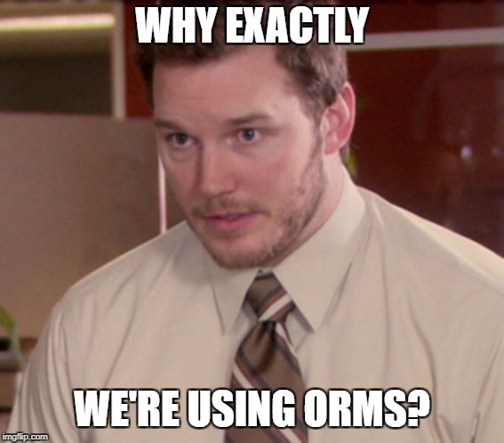

Slide 38
Why we’re using ORMs?
Easier and faster development of DAL
Lower entry threshold to work with databases
You can think about your data in object oriented way
You don’t even need to know SQL at all!

Slide 39

You don’t even need to know SQL!

Slide 40
Short Summary
You can completely ignore your database
You can create DAL blazingly fast
You can watch it goes to hell when your project is mature enough to produce big data loads.

Slide 41
Why we’re using ORMs (seriously)?
They handle non-complex cases well enough
Development time is expensive…
… and we can rewrite problematic queries some time later
Not every query requires polishing and perfecting
Not everyone is supposed to be SQL experts
They’re easy and they work (usually)

Slide 42
When should we consider other options?
When performance is critical
When it’s much easier to write raw SQL than complicated LINQ
When we’re encountering performance problems related to DAL and bloating of DB
When we need/want to use some advanced database features

Slide 43


So, ORMs are bad?

Slide 44


Sometimes you need a chainsaw, sometimes you need a scalpel

Slide 45
New Stuff in SQL Server 2016+ and Azure SQL

Slide 46
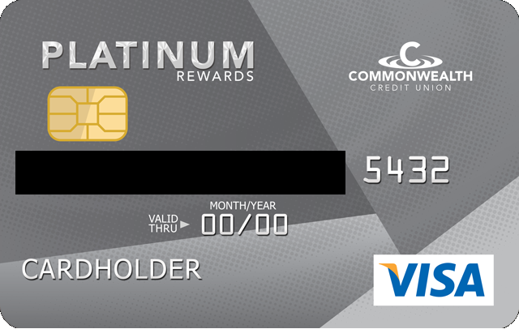
Dynamic data masking

Slide 47
Data we could want to mask
Credit card numbers – XXXX-XXXX-XXXX-1234
Emails - rXXXX@XXXXXXXXXi.net
Dates - 1900-01-01
Personal information - Rafał H.

Slide 48
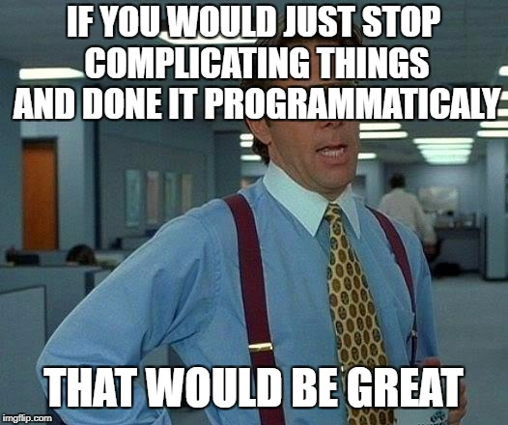

Slide 49
When to use Dynamic Data Masking?
When confidential data shouldn’t accidentally leave database (but it’s not bulletproof!)
When we’re already using database logins and users for managing data access policy

Slide 50
Creating column with DDM
CREATE TABLE [dbo].[DDM]
(
[Email] nvarchar(256)
MASKED WITH (FUNCTION = 'email()') NOT NULL
[CredicCard] nvarchar(20)
MASKED WITH ( FUNCTION =
'partial(0,"XXXX-XXXX-XXXX-",4)') NOT NULL
)

Slide 51
Masking types
Default – depends on masked type
Random – random number instead of value
Email – rXXXX@XXXX.com
Custom – our own pattern

Slide 52
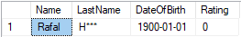
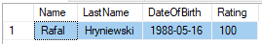
Masked/Unmasked

Slide 53
Granting/Revoking UNMASK permission to user
GRANT UNMASK TO SQLUserName;
REVOKE UNMASK TO SQLUserName;

Slide 54
Querying masked data
All queries, inserts, deletes and updates will work normally
Only results are masked and not modified in any way
DDM is not ultimate security feature, because you can write queries as usual it’s possible to brute force enough data to figure out any masked value.

Slide 55
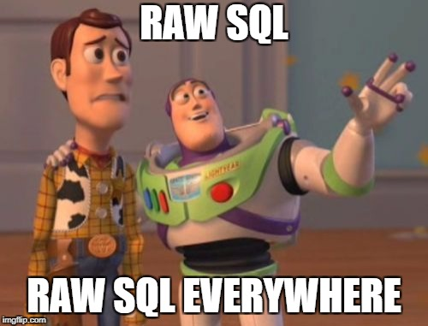
How to use DDM in Entity Framework?

Slide 56
All access depends on user you’re providing in connection string!
"data source=DBADDRESS.database.windows.net;initial catalog=testdb;persist security info=True;user id=YOURUSERLOGIN;password=YOURPASSWORD;MultipleActiveResultSets=True"

Slide 57

Row Level Security

Slide 58
Row Level Security
Limiting access to data on row level
Handled by Table Valued Function
Most of the time it’s used with SQL Session and/or logged in user

Slide 59
Row Level Security – when to use?
One-database multi-tenant solutions
One column with value that can be used in filter ie. “TenantId”
When there is value that you’ll always filter against and if someone will forget about this predicate, it could result in leaking data ie. “TenantId”

Slide 60

Row Level Security – how to?

Slide 61
Row Level Security – identify column
CREATE TABLE [dbo].[Employees]
(
[Id] bigint IDENTITY(1,1) NOT NULL,
[CompanyId] bigint NOT NULL,
[FirstName] nvarchar(200) NOT NULL,
[LastName] nvarchar(200) NOT NULL,
[Email] nvarchar(260)
);

Slide 62
Row Level Security – create function
CREATE FUNCTION [sec].[FN_Predicate](@CompanyId bigint)
RETURNS TABLE
WITH SCHEMABINDING
AS
RETURN
SELECT 1 AS Result
WHERE
CAST(SESSION_CONTEXT(N'CompanyId') AS int) =
@CompanyId;

Slide 63
Row Level Security– attach security policy
CREATE SECURITY POLICY [sec].[Filter]
ADD FILTER PREDICATE [sec].[FN_Predicate](CompanyId)
ON [dbo].[Employees],
ADD BLOCK PREDICATE [sec].[FN_Predicate](CompanyId)
ON [dbo].[Employees] AFTER INSERT,
ADD BLOCK PREDICATE [sec].[FN_Predicate](CompanyId)
ON [dbo].[Employees] BEFORE DELETE,
ADD BLOCK PREDICATE [sec].[FN_Predicate](CompanyId)
ON [dbo].[Employees] BEFORE UPDATE
WITH (STATE = ON);
GO

Slide 64
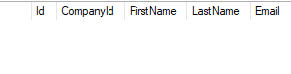
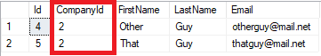
Row Level Security – querying
SELECT *
FROM [Employees]
SP_SET_SESSION_CONTEXT
@key=N'CompanyId’
,@value=2;
SELECT *
FROM [Employees]

Slide 65
RLS in Entity Framework – setting session in ctor
public EmployeesDbContext(ICompany company) {
companyId = company.Id;
this.Database.Connection.Open(); //Required
SetCompanyIdInSqlSession();
}
private void SetCompanyIdInSqlSession() {
var sqlParameter = new SqlParameter("@companyId", companyId);
this.Database.ExecuteSqlCommand(
sql: "SP_SET_SESSION_CONTEXT @key=N'CompanyId' ,@value=@companyId",
parameters: sqlParameter);
}

Slide 66
RLS in EF – setting session on connection state change
public EmployeesDbContext(ICompany company) {
companyId = company.Id;
Database.Connection.StateChange += OnConnectionOpened;
}
private void OnConnectionOpened(object sender, StateChangeEventArgs e) {
if (e.CurrentState == ConnectionState.Open)
SetCompanyIdInSqlSession();
}

Slide 67

Temporal Tables

Slide 68
Temporal Tables
A.K.A – System Versioned Tables
Query for state in any point of time
Query and aggregate state changes for specified time period
Basically it’s ordinary table backed by table with historical record with columns indicating time range when it was valid

Slide 69
Temporal Tables – when to use?
When it’s important to store and/or analyze historical data
When you need to generate reports based on historical records
When you want to restore application state for given point in time easily
When you want to use ordinary table in ordinary way but you want to gather data about state changes over time

Slide 70
Temporal Tables – creating table in SQL
CREATE TABLE [dbo].[Products]
([Id] uniqueidentifier NOT NULL,
[Name] nvarchar(200) NOT NULL,
[Price] decimal(19,4) NOT NULL,
[Quantity] int NOT NULL,
[StartTime] datetime2 GENERATED ALWAYS AS ROW START
CONSTRAINT [DF_Products_StartTime] DEFAULT SYSUTCDATETIME(),
[EndTime] datetime2 GENERATED ALWAYS AS ROW END
CONSTRAINT [DF_Products_EndTime] DEFAULT CONVERT(datetime2 (0), '9999-12-31 23:59:59'), PERIOD FOR SYSTEM_TIME ([StartTime], [EndTime]),
CONSTRAINT [PK_Products] PRIMARY KEY CLUSTERED ([Id]))
WITH
(SYSTEM_VERSIONING = ON
(HISTORY_TABLE = [dbo].[ProductsHistory]));

Slide 71
Temporal Tables – creating table in SQL
CREATE TABLE [dbo].[Products]
(--...
[StartTime] datetime2 GENERATED ALWAYS AS ROW START
CONSTRAINT [DF_Products_StartTime] DEFAULT SYSUTCDATETIME(),
[EndTime] datetime2 GENERATED ALWAYS AS ROW END
CONSTRAINT [DF_Products_EndTime] DEFAULT CONVERT(datetime2 (0), '9999-12-31 23:59:59'),
PERIOD FOR SYSTEM_TIME ([StartTime], [EndTime]))
WITH
(
SYSTEM_VERSIONING = ON
(
HISTORY_TABLE = [dbo].[ProductsHistory]
));

Slide 72
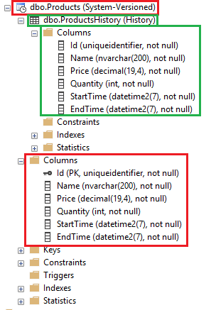
Temporal Tables – Versioned and History Tables

Slide 73
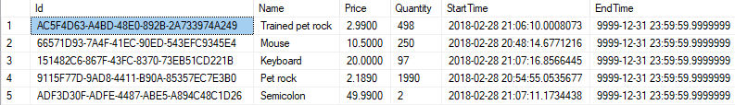
Temporal Tables – Versioned Table (Current State)
SELECT * FROM [dbo].[Products]

Slide 74
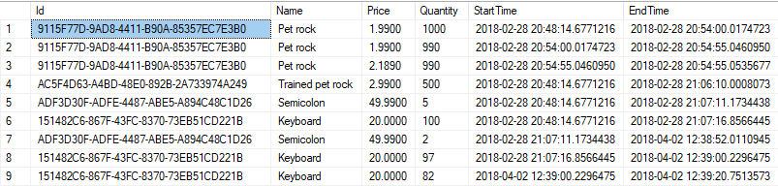
Temporal Tables – History Table
SELECT * FROM [dbo].[ProductsHistory]

Slide 75
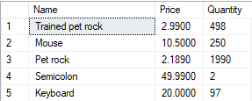
Temporal tables – state for specific point of time
SELECT [Name], [Price], [Quantity]
FROM [dbo].[Products]
FOR SYSTEM_TIME AS OF '2018-02-28 21:50'

Slide 76
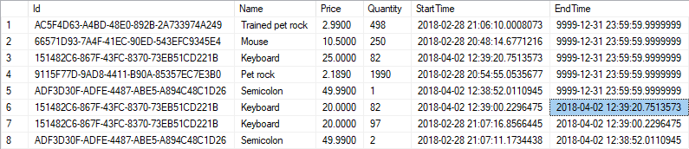
Temporal tables – changes over time range
DECLARE @now datetime2 = getutcdate();
SELECT * FROM [dbo].[Products]
FOR SYSTEM_TIME
BETWEEN '2018-03-01' AND @now
ORDER BY [EndTime] DESC

Slide 77
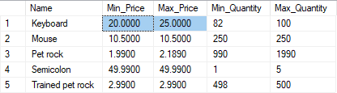
Temporal tables – aggregation on historical data
SELECT [Name],
MIN([Price]) AS Min_Price, MAX([Price]) AS Max_Price,
MIN([Quantity]) AS Min_Quantity, MAX([Quantity]) AS Max_Quantity
FROM [dbo].[Products]
FOR SYSTEM_TIME
BETWEEN '2018-01-1' AND @now
GROUP BY [Id], [Name]

Slide 78

How to apply this magic in ORM?

Slide 79

You don’t!

Slide 80
Unless you really must. Then:
Use Micro ORM like Dapper
OR
For inserts, updates and deletes you should create stored procedures and map them in Entity Framework.
For ordrinary queries you can map versioned table or some kind of view.
For querying with SYSTEM_TIME you should create and map your own SQL functions (details in one of my blog posts)

Slide 81
Temporal Tables – tips
Entity Framework doesn’t work with Temporal Tables without some custom settings during mapping and tricky interceptor, to handle SYSTEM_TIME columns.
Use raw SQL or create and map procedures, views and/or functions to interact with versioned tables.
If you really need ORM – consider using micro ORM (ie. Dapper), those are more flexible.
Be careful about table size and set retention period and/or partition/stretch.

Slide 82
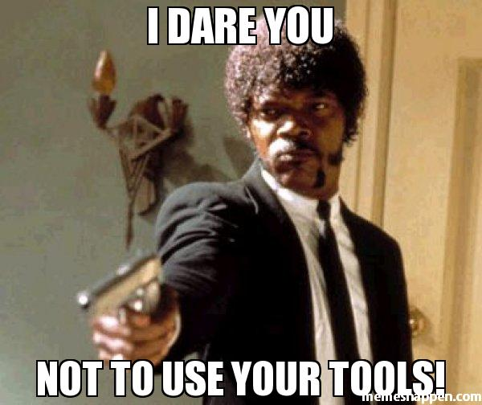
Best tool for working with SQL which you won’t see in Visual Studio?

Slide 83
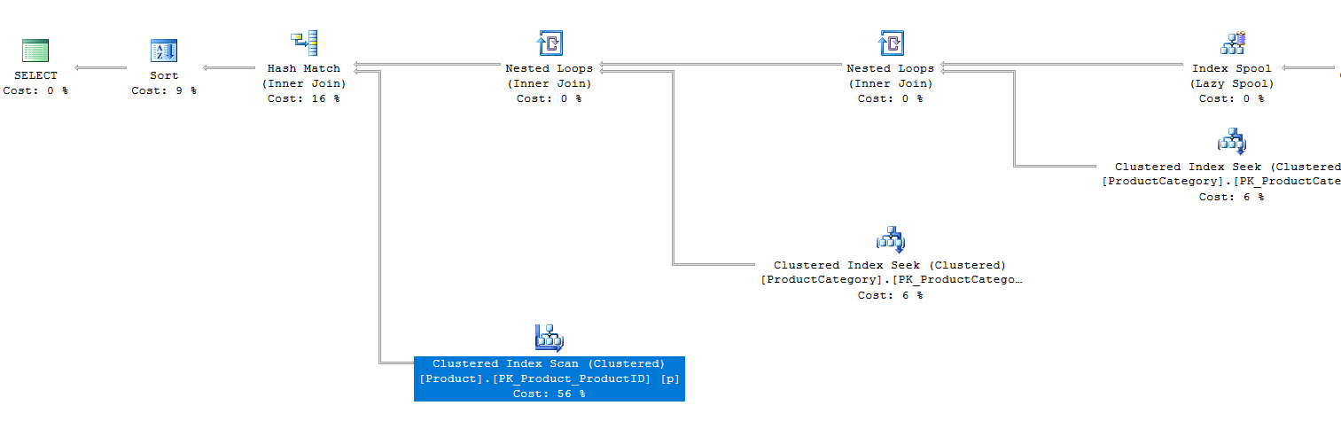
Execution Plans

Slide 84
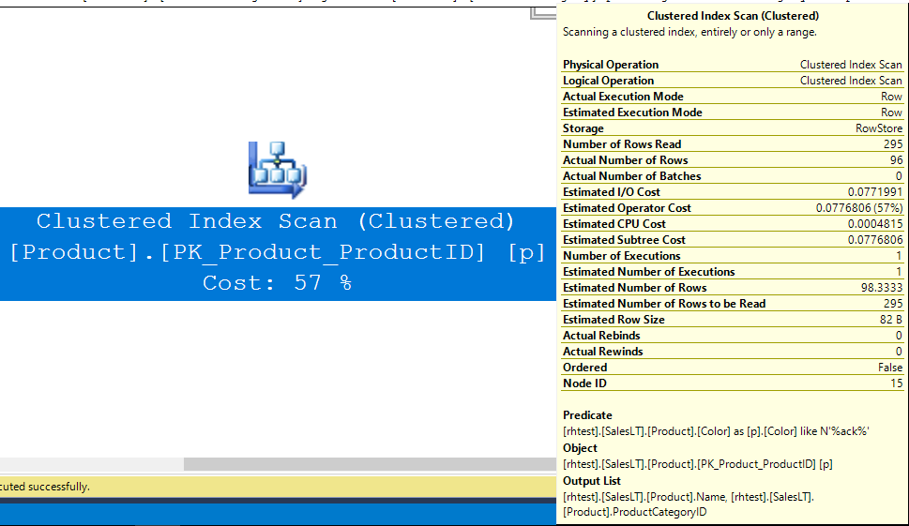
Execution Plans – Interpretting operations and finding problems

Slide 85
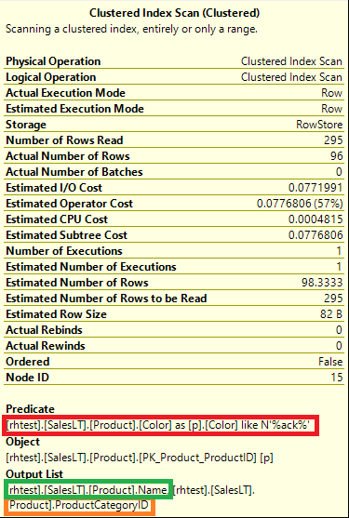
Execution Plans – Fixing problems
CREATE NONCLUSTERED INDEX AwesomeIndex
ON [SalesLT].[Product]
([ProductCategoryID],
[Color])
INCLUDE ([Name])

Slide 86
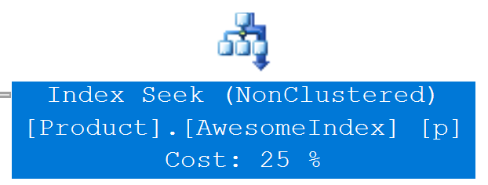
Voila!

Slide 87
Notable Mentions – JSON Support (2016+)
Since MS SQL 2016 it’s possible to operate on JSON with set of built-in functions like OPENJSON, JSON_VALUE, JSON_QUERY and JSON_MODIFY.
Any nvarchar(max) could be used as JSON as long as it contains valid JSON. You can check it with ISJSON function.
You can build your own functions, views and procedures around it and map them in your ORM.
More details: https://channel9.msdn.com/Shows/Data-Exposed/SQL-Server-2016-and-JSON-Support

Slide 88
Notable Mentions – Graph Databases (2017+)
If you really need to build complex and tangled relationships in your data model you can use limited graph database possibilities since SQL Server 2017
Graphs consists of node and edge tables
It’s still RDBMS so tooling and syntax are not so well-developed as Neo4J or Gremlin
More details: https://channel9.msdn.com/Events/Connect/2017/T146

Slide 89
Notable Mentions – Other stuff that you could’ve missed
Partitioning
Stretching database
Columnstore Indexes
Transparent Data Encryption

Slide 90

ORM = Faster Development and Limited Options

Slide 91

Don’t think in object oriented way while working with database

Slide 92

Most of advanced DB features can be exposed via views, procedures and functions...
...and those can be mapped in ORMs or used in raw SQL

Slide 93

Sometimes it’s easier to write raw SQL than use ORM for the same effect

Slide 94

Programming in SQL is possible (and fun!)

Slide 95

You can use ORM without knowing SQL. And you can drive a car without license. It doesn’t mean you should!

Slide 96

You don’t have time to care about performance of complex queries?
Will you find time when production database will grow and just start causing problems?

Slide 97

ALWAYS use parameters in raw SQL instead of putting strings together! Ever heard about SQL Injection

Slide 98

Should you dive into SQL?

Slide 99
Why should you dive into SQL?
You will understand it and use it to write better queries even against ORMs
You will be able to identify possible performance bottlenecks
You will know when to use chainsaw and when to use scalpel
It’s a brave new world out there!

Slide 100

Should I stop using ORMs?

Slide 101
Why shouldn’t I stop using ORMs?
While you can fight for every millisecond it’s often waste of time
Most operations should be simple and therefore easily handled with ORMs
Most of the time it’s development time that is crucial
Using raw SQL and ORMs is not mutually exclusive

Slide 102
Resources (from easiest)
scarydba.com – Grant Fritchey’s Blog (Database Fundamentals cycle)
app.pluralsight.com/profile/author/joe-sack – Joe Sack on Pluralsight
Book – “Pro T-SQL Programmer's Guide” Natarajan, J., Bruchez, R.
Book - “Pro SQL Server Internals” Korotkevitch, D.

Slide 103
Samples and more details on my blog
http://bit.ly/bn-rh

Slide 104

Questions?

Slide 105
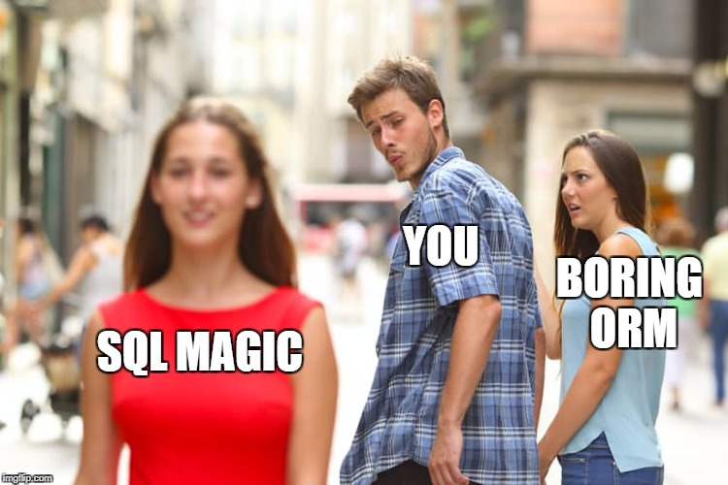

Ask me anything, grab a sticker and try it yourself!
fb.me/hryniewskinet
@r_hryniewski

